Slide 1
Implementing CI/CD Pipelines in a NetDevOps Environment
Christian Adell
AutoCon3 May, 2025
https://github.com/networktocode/autocon2-cicd-workshop/

Slide 2
Introduction

Slide 3




Who is standing in front of you
Przemek Rogala
Automation Architect
Christian Adell
Automation Architect
Paddy Kelly
Director Solutions Engineering
Federico Olivieri
Solutions Engineer

Slide 4
DevOps Principles
Notes:
As you know, CI/CD or Continuous Integration and Continuous Deployment, follows closely the DevOps principles.
Helps us to know where we are, where we want to go, and how does this tool help us to get there?
Shorter version of my LinkedIn learning course.

Slide 5
What is DevOps?
- Developers
- QA Engineers
- Operators
- System
Administrators
- Network Administrators
Notes:
First of all, what is DevOps?
Once upon a time, there was just developers and QA engineers that developed shrink-wrapped softwares.
My experience at Microsoft, walking into building 36 for Windows.
Then came SaaS and the Internet, where we delivered the end software over the network. Now we have the operators, system and network administrators, and support engineers.
***
*As one can guess from the terms, it is a combination of software development (Dev) and IT operations (Ops).
Traditionally we would have separated, semi-isolated teams with one team handling the development of software features, once it is done, hand it over to the operations for deployment and operation. Over time, the two teams grew apart with different priorities, use different tools, and created some frictions.
For the majority of my career I belong squarely in the operations camp. As a network engineer, I can recount many war stories of provisioning vlan at the last minute, scrambling to configure firewalls, and making various last minute changes to the network; all the while making sure all of the changes conform to the security standards.
DevOps is meant to bring the two teams closer together by leveraging the same technologies, share the same vocabularies, build better collaboration, and deliver faster results.

Slide 6
People + Process + Tools
People
Process
Tools
Notes:
Another way to think about DevOps is with the three inter-related categories of People, Process, and Tools. This is my favorite graph.
For example, we have a group of engineers who share the same principles (we will talk about what those principles are), collaboratively define a set of processes conforming to these principles, and use a set of tools that enforce the process. In term, the tools will provide feedback to the engineers to further validate the principles and processes. We might change the process often and principles less (but they are not set in stone).
I believe one of the most overlooked area of this trifecta is the people part (environments that are successful take the time to recognize the operators):
- Recognize human nature (I am at my best at 2am in the morning, says nobody ever)
- Need to make the process and tools easy, 1 click update all the tickets and notifications, use git to consolidate changes, etc.
- Tools & process should yield to People

Slide 7
DevOps Overview
Shorten Development to Deployment life cycle
Closely related to Agile and Lean software development
Design
Develop
Feedback
Deployment
Notes:
*As we have mentioned, the primary goal of DevOps is to shorten the software cycle from development to deployment.
In network engineering, we can draw many parallels to the same design, develop, deploy, and feedback loop in software development.
***
For example, we can put together a new data center design, develop an action plan to validate the design, then move forward with deployment and monitoring. A DevOps principle such as version control can be applied to all of these steps. They can also benefit from another DevOps principle of making small, incremental changes that can quickly respond to the changing environment.
*The DevOps principles are highly related to the Agile and Lean software development. So let’s take a look at the Lean Principles and Agile Development Process before we conclude this lesson with the DevOps Principles.
Again, DevOps originated in software development, however, almost all of the principles are still applicable in network engineering.
This was one of my Ah-Ha moment, doesn’t matter what term we give it, network engineering already follow the same process, we just need to formalize it.
***
Besides taking part as the operations team in an organization, let’s look at how we can draw parallel and adapt the DevOps principles within network engineering itself.
* If we think about the network life cycle, initially, we would receive some requirements for our network, it can be a corporate campus, a data center, or retail store and we would design the network accordingly.
We would then develop the topology, necessary equipment, software license, port count, and so on.
Then we would deploy the equipment per our design. This could be the actual rack and stack, configure the equipment, and all the necessary supporting infrastructure such as IP management, DNS, DHCP, Firewall policies, etc.
Once it is deployed, we will continue to operate and monitor the network. Maybe we are adding new users, VLANs, servers, security policies, and we will continue to monitor the health of the network to make sure they are operating in an optimal state.
Inevitably, even the best designed and operated network will need to be updated with new features, new business requirement, and we will repeat the cycle again.
Since the network engineering cycle is very similar to software development, in my opinion, the existing DevOps best practices can and should be adapted into network engineering as well.

Slide 8
Tools: Continuous Integration / Deployment
Development
Check-In (Version Controlled)
Dev
Deployment
Automated Testing
Ops
Notes:
We picked GitLab as the platform of tools for illustration, but to be honest, the tools is the easiest part to swap out. The priority should be:
People
Principles
Processes
Tools
***
*The first DevOps practice is to have a source of truth for the software code, documentation, device configuration, or network state. This usually means a distributed version control system that all team members can refer to.
*The second DevOps practice is to have automated testing. Because we are trying to put our emphasis on small, incremental changes, we should aim to have automated testing that ensures we do not accidentally break things when these changes are made.
*We should aim to have a system of continuous integration. This means having a system for each developer and operations personnel put their changes into the source of truth as quickly as possible. This change can range from software code, device state, network configuration, and so on. It should also be pointed out the continuous integration means to have the changes make their way to the source of truth or version control system and does not equate to deployment.
*Once we have continuous integration, we can take the next step for continuous delivery or continuous deployment. What is the difference between the two? Sometimes we do not have control over deployment and just delivery, such as when we have the changes in an updated docker image, or when we have a mobile app that is only deployed when the client pulls the changes in.
*Another DevOps practice is to implement a high-trust culture for the individuals and between teams. Examples of this practice can be peer review for changes as well as a blameless culture between developers and operators.

Slide 9
NetDevOps Processes / Practices
Version Control
Code, Data, Files
Continuous Integration
Automated Testing (unittest to integration testing)
Continuous Delivery or Deployment
Deployment releases code to production; delivery readies it for release
Team Ownership
Peer Review and blameless culture
Notes:
*The first DevOps practice is to have a source of truth for the software code, documentation, device configuration, or network state. This usually means a distributed version control system that all team members can refer to.
*The second DevOps practice is to have automated testing. Because we are trying to put our emphasis on small, incremental changes, we should aim to have automated testing that ensures we do not accidently break things when these changes are made.
*We should aim to have a system of continuous integration. This means having a system for each developer and operations personal put their changes into the source of truth as quickly as possible. This change can range from software code, device state, network configuration, and so on. It should also be pointed out the continuous integration means to have the changes make their way to the source of truth or version control system and does not equate to deployment.
*Once we have continuous integration, we can take the next step for continuous delivery or continuous deployment. What is the difference between the two? Sometimes we do not have control over deployment and just delivery, such as when we have the changes in an updated docker image, or when we have a mobile app that is only deployed when the client pulls the changes in.
*Another DevOps practice is to implement a high-trust culture for the individuals and between teams. Examples of this practice can be peer review for changes as well as a blameless culture between developers and operators.

Slide 10
Today’s Labs

Slide 11
CI/CD Labs
Part 1
The Basics
Lab 1
Basic Git
Lab 2
First Pipeline
Lab 3
Collaboration Tools
Part 2
Use-Cases
Lab 4
Source Code Checks
Lab 5
Generate Configs
Lab 6
Testing Frameworks

Slide 12
Agenda
9:00
Introduction
Lab 1,2,3
10:00
BREAK
11:00
Lab 4,5,6
12:00

Slide 13
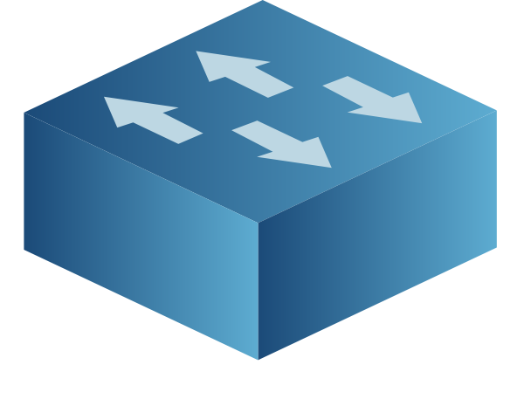
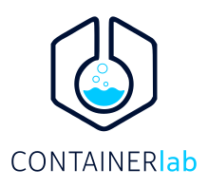
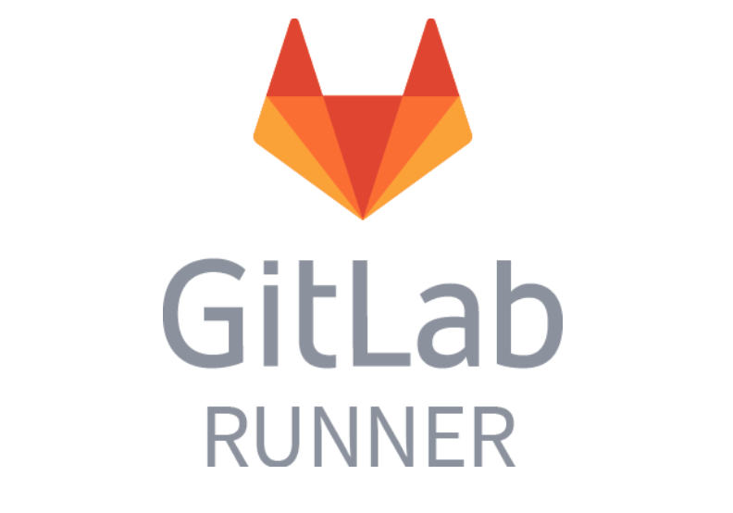

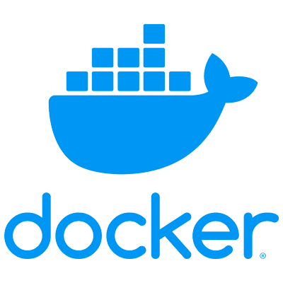
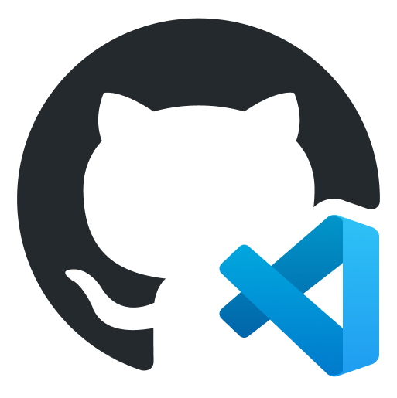
The Scenario
DEV ENVIRONMENT
VERSION CONTROL
CICD PIPELINE
TERMINAL / EDITOR
GitHub Codespaces

Slide 14
NTC Training Pod

Slide 15
Training Environment
Portal -> Operate -> Operation Hub
Select the autocon3-cicdworkshop-podxx, and “Quick Access”
You can SSH into the Pod via SSH (including VSCode remote extension) or use remote desktop
Use “docker ps” command to quickly check if your gitlab runner and clab containers are running
-> git clone https://github.com/networktocode/autocon2-cicd-workshop.git
In https://github.com/networktocode/autocon2-cicd-workshop/blob/main/clab/ceos-lab.clab.yml update:
topology:
kinds:
ceos:
image: "ceos:4.32.0F" -> "networktocode/clab-ceos:4.30.4M"

Slide 16
Training Environment - Tips
For labs 4-6
Each time you switch between branches remember to update “tags” in .gitlab-ci.yml to match the tag set for your runner
Remember to update host IPs in the ContainerLab “hosts.yaml” file
If you started pipeline run before updating “tags” for the runner, cancel the run, update the “tags” in .gitlab-ci.yml and push the change

Slide 17
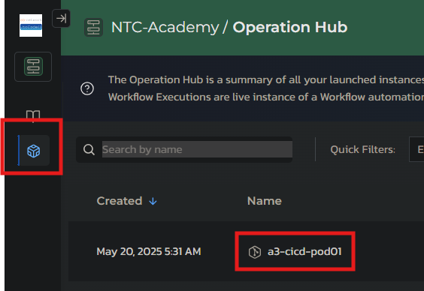
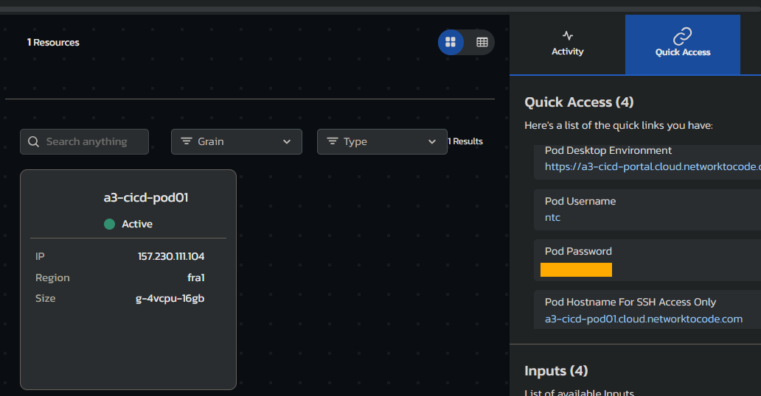
Connecting local VSCode to the lab environment
In the NTC-Academy Portal click on the “Operation Hub” icon on the left hand side
Click on the name of your pod, here “a3-cicd-pod01”
On the pod details page, click on the “Quick Access” tab on the right hand side
Make note of the username, password and pod hostname for the SSH access

Slide 18
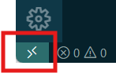

Connecting local VSCode to the lab environment
Open VSCode and ensure you have “Remote - SSH” extension installed
With extension installed, click on “Open a Remote Window” icon in the lower left corner
An input will pop up at the center top of the VSCode window. Choose “Connect to host” and enter ntc@<your_pod_name> as the name of the host
When asked about type of the machine, select Linux
Enter password when prompted
Once connected to the pod, go to “File -> Open Folder” and choose “home/ntc”, enter the same password when prompted
You can now work with the lab from your VSCode instance

Slide 19
Labs Concepts

Slide 20
What goes into a Version Control System?
VERSION CONTROL SYSTEM
CODE / SCRIPTS
(e.g., Python, Go, Ansible playbooks)
DATA
(e.g., YAML, JSON)
TEMPLATES
(e.g., Jinja2)
CONFIG ARTIFACTS
(e.g., CLI, JSON)
TESTS
(e.g., pytest, batfish)
DOCUMENTATION
(e.g., markdown, mermaid)
PIPELINES
(e.g., gitlab CI, github actions)

Slide 21
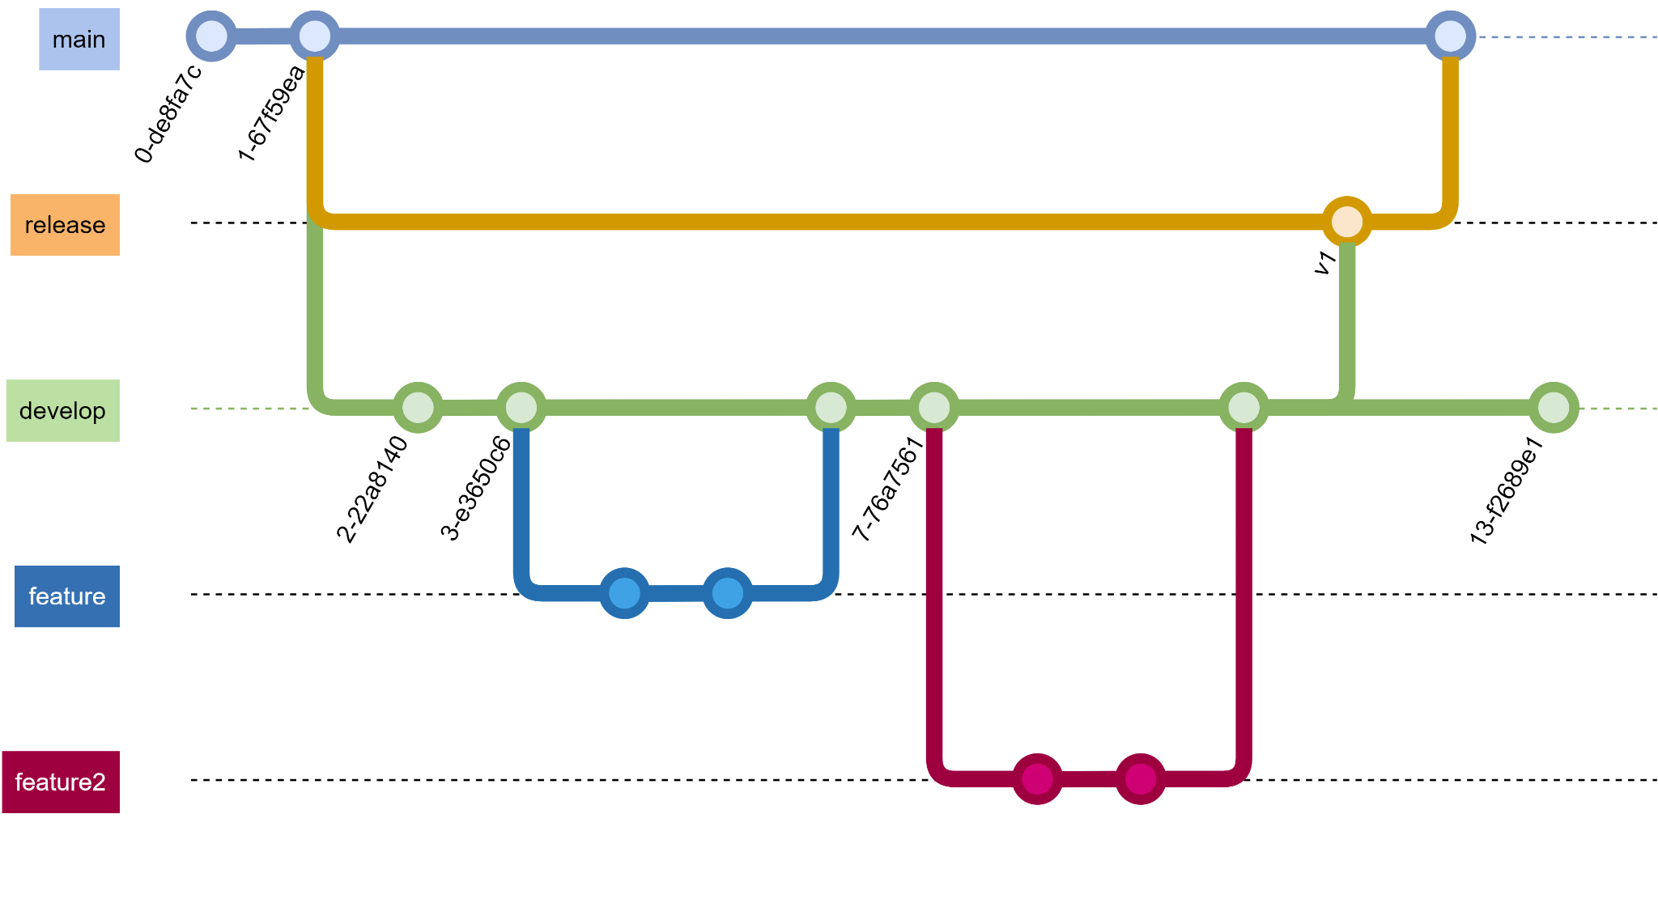
Git - Fundamentals
branch
commit
merge
tag

Slide 22
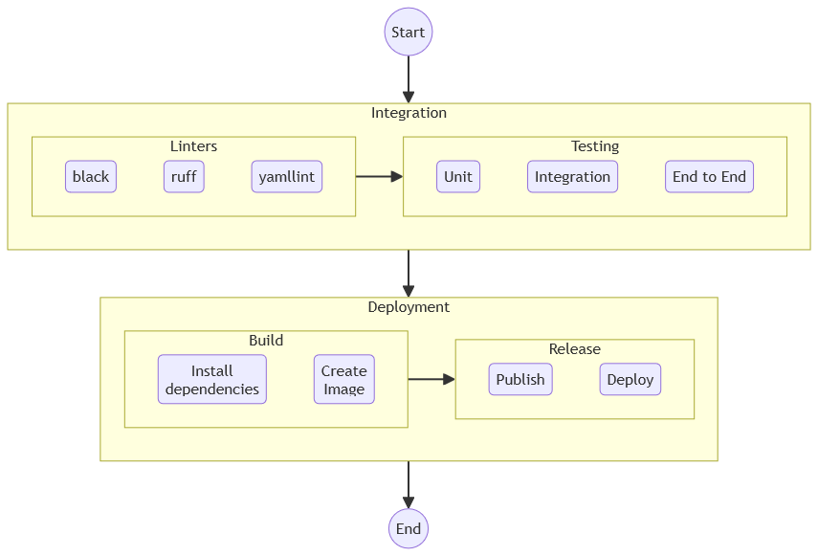
Continuous Integrations and Continuous Deployment (Lab 4)

Slide 23
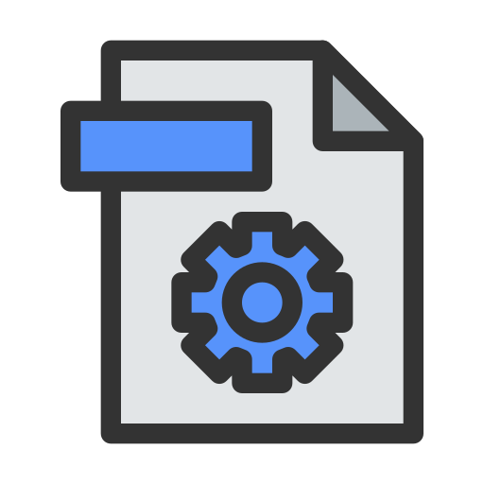
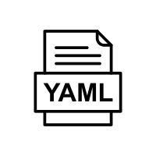


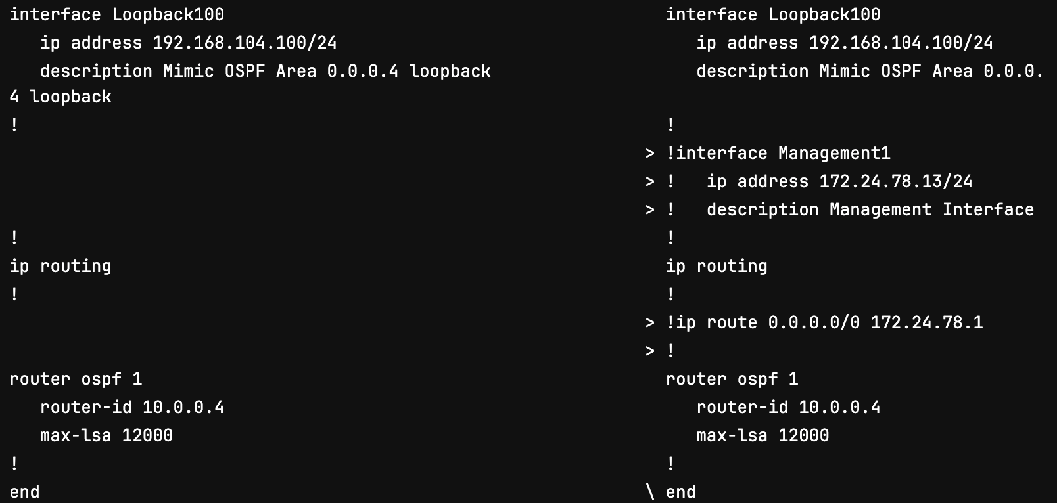
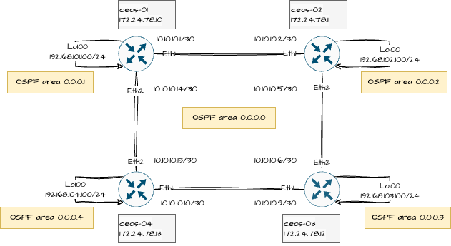
Network Configuration Scenario (Lab5)
Changes in data
Config
Reference
Nornir
Diff Config
Nornir
Generate Config
Config
Artifact

Slide 24


Pre and Post Validation (Lab 6)
Changes in data
Config
Reference
Nornir
Diff Config
Nornir
Generate Config
Config
Artifact
Nornir
Push Config
Pre-validation
Post-validation

Slide 25
Thank You

